Slide 1

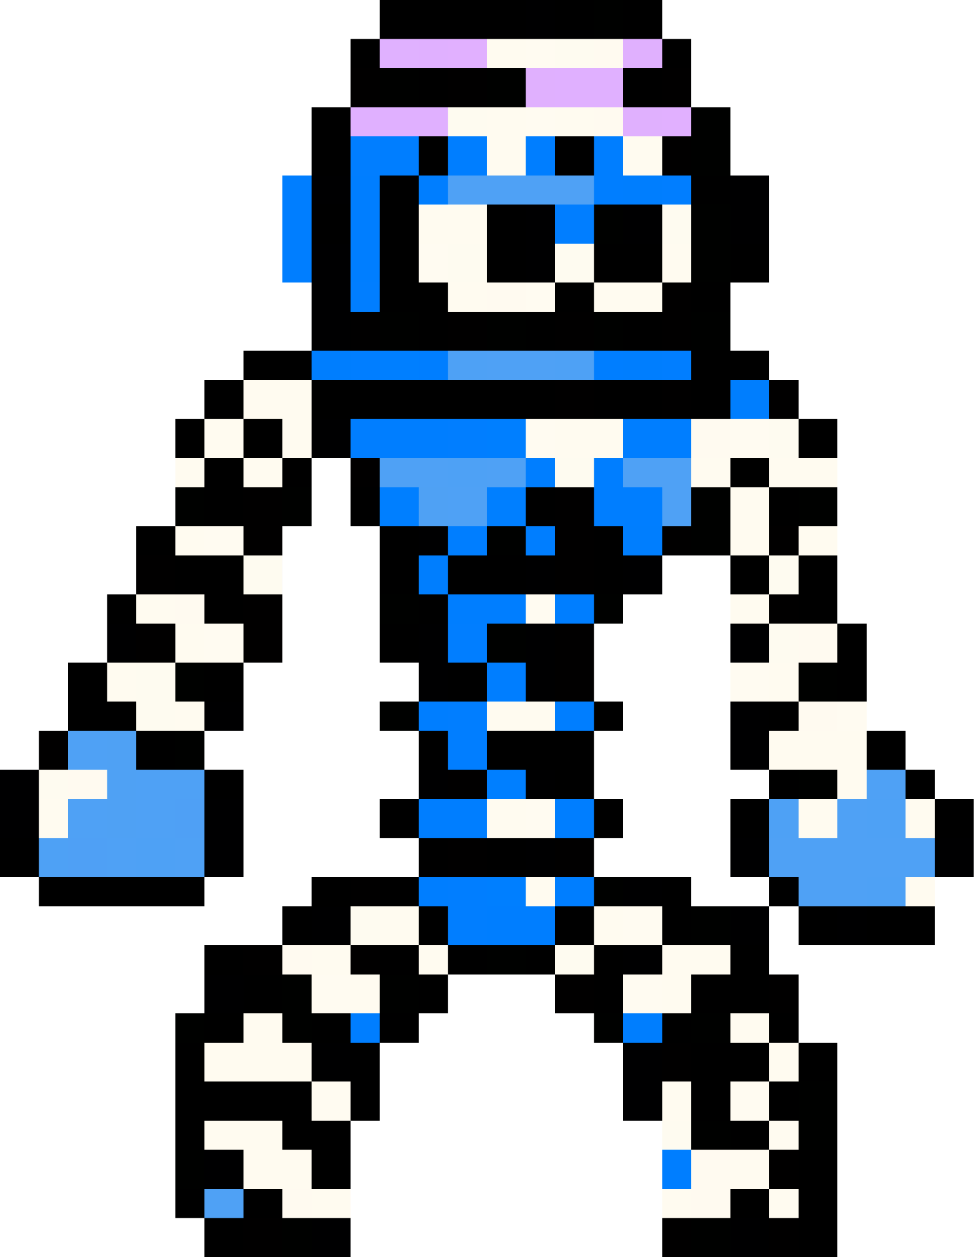

SPRINGRUNNERS
Group 10 - Jeff, Joseph, Lawrence, Malachi

Slide 2


Elevator Pitch
Professional Reviews
Get ready to bounce, leap, and grapple your way through an electrifying platforming adventure in Spring Runners! Take control of a charismatic character made entirely of springs as you navigate treacherous levels, avoiding the deadly wall of springs that threatens to fling you off the screen. Utilize your jumping skills, unleash powerful super jumps, and strategically grapple to blocks to reach new heights.
But the ultimate challenge awaits in the epic boss level, where you must dodge magnetic projectiles that slow you down and outmaneuver your dashing, yet deadly, creator. Will you conquer the spring factory and emerge as the ultimate Springrunner? Get ready to spring into action!
- a must play for spring enthusiasts and running savants. 10/10
- play it or else. 10/10

Slide 3

Trailer

Slide 4





Players Love Our Game!
“I like the lore of the spring guy. It was a life changing experience.”
- An enthusiastic Player
“Fun. Easy controls.”
- An experienced Player
“The projectiles were a fun challenge.”
- An enthusiastic Player
“Ur mum.”
- An Anonymous Player
“I enjoyed swinging on the ziplines.”
- An experienced Player
“The simplicity of the game was nice and the spring-death animation was funny.”
- An Anonymous Player
Notes:
Average enjoyment of about 4.1 (4.083) or 5
beginning difficulty (3 of 5) -> ending difficulty of 3.83 of 5.
—
About the right level of challenge for our players, starting almost perfectly at moderate difficulty (3 of 5) with the earlier levels moving to more challenging at the end with a higher difficulty of around 3.83 of 5

Slide 5
Questions?

